Slide 1
LEVEL 1 - HTML & CSS BASICS
(XX Weeks, XX Projects)

Slide 2
Level 1 – HTML Basics
Days | Topics | Achieved Skills
Day 1 | Install VSCode and run basic HTML page Content Elements Media Elements Block Elements HTML attributes | Run the code from IDE and view pages Create a page structure, add text and images Using Brower Dev tools
Day 2 | Form Elements Table Elements HTML Events | Using input elements like Text box/area, Password, checkboxes, radio boxes, Dropdowns, Progressbar buttons Designing a table Intro to basic HTML Events
Day 3 | Project #1 | Authoring a comprehensive page with content, images, tables and input elements

Slide 3
Level 1 – CSS Basics
Days | Topics | Achieved Skills
Day 1 | Selectors – Elements, Class, id CSS Typography – Fonts, Alignment, Spacing Icons – Images, Fontawsome Box Model | Apply styling to HTML elements Using google fonts Applying margins, padding, borders
Day 2 | Project #1 | Learning debugging skills to resolve overlapping and hierarchical styles
Day 3 | CSS Layout – Position, Float, Display Project #2 | Design a CARD based UI to manage the spacing and alignments
Day 4 | Lists Project #3 | Customizing list elements
Day 5 | Forms - Custom design Project #4 | Customizing form input elements

Slide 4
Level 1 – CSS Advanced
Days | Topics | Achieved Skills
Day 6-7 | Login Pages Project #5 | Develop a production grade page additionally covering css selectors, inline icons and fonts
Day 8 | Registration Page Project #6 | Developing production grade forms with custom input fields
Day 10 | Menus Project #7 | Designing Vertical and Horizontal Menus with hierarchy
Day 11 | Table Project #8 | Custom table design with icons, input elements added in rows
Day 12-13 | Dashboard Project #9 | Mastering box model and layout features

Slide 5
Level 1 – CSS RWD
Days | Topics | Achieved Skills
Day 14 | Responsive Web Design Media Queries | Developing a web page that automatically adjust to the different screen sizes and view ports
Day 15 | Project #10 | Designing cards page to work responsive
Day 16 | Intro to Bootstrap Bootstrap Components | Understanding of bootstrap elements, designs and applying customization
Day 17-18 | Project #11 | Redesign Dashboard with Bootstrap

Slide 6
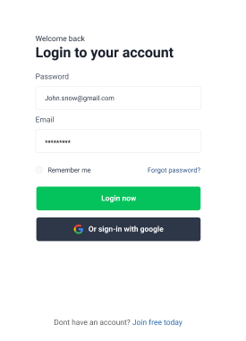
HTML
Label, Input (text, password and checkbox), button, Image , anchor
CSS
Box Modal
Width, Height,
Padding
Border, Border Radius, Box shadow
Margin (auto)
Position (relative, absolute)
Effects:
focus, hover, visited, etc..
Typography Styles
Font Family, Size, weight, Color, Google fonts,
Images
Font awesome Icons, and Images ex.
Images (Using with png, jpeg, svg formats)
https://icons8.com/ & https://www.flaticon.com/
Background
Background Color and image
https://www.figma.com/file/yH8YJJ0AhrcYWJnO303ybh/Login-View-(Community)?node-id=1%3A2

Slide 7
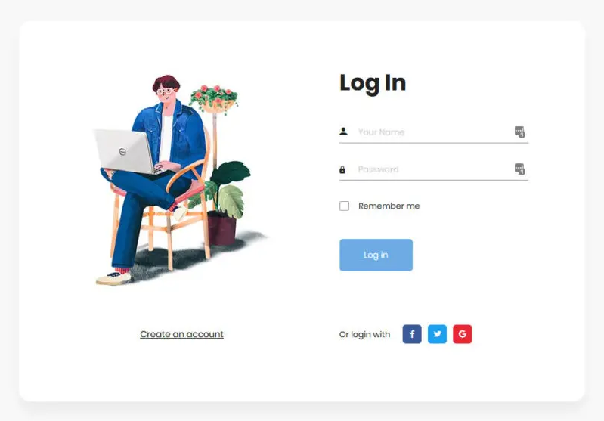
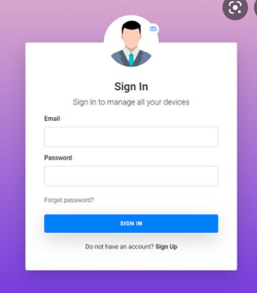
Sign In Form

Slide 8
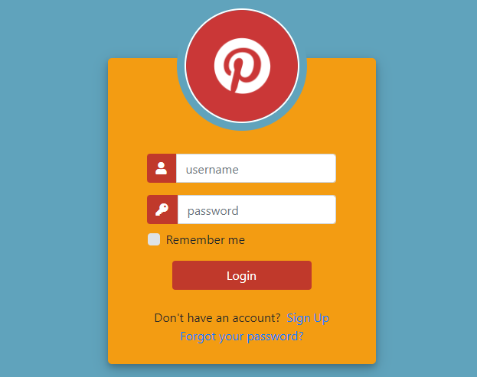
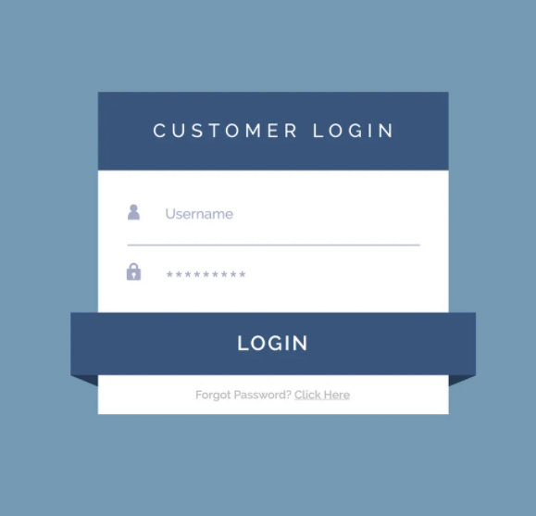

Slide 9
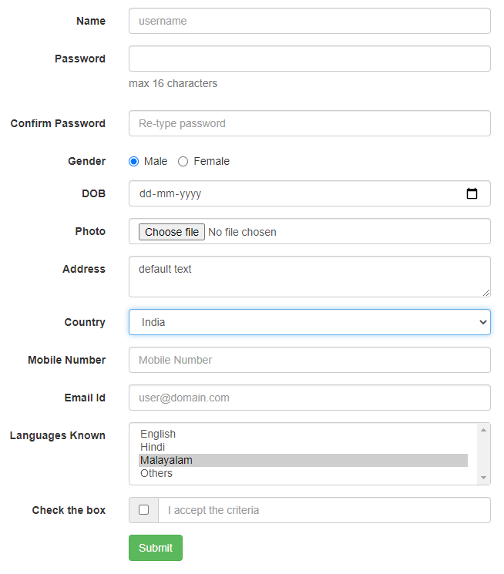
Sign Up Form
https://bootsnipp.com/snippets/3XMOV

Slide 10
Header
  Details
  Logo section
  Profile section
  Content/Other action items (search, dropdown, settings, filters, etc….)

Slide 11
Horizontal Menu
  Details
  Menu Items
  Menu Items with Icons
  Menu Items with dropdown

Slide 12
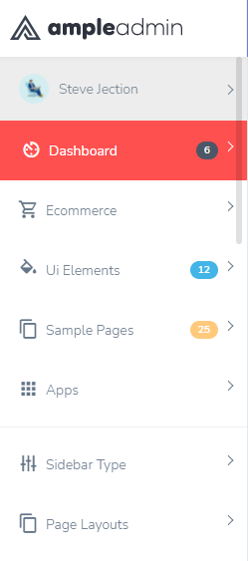
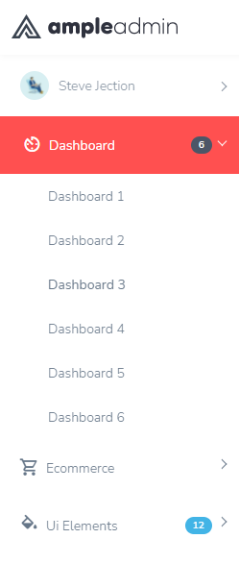
Vertical Menu
Details
Menu Items with Icons
Expand Menu Item

Slide 13
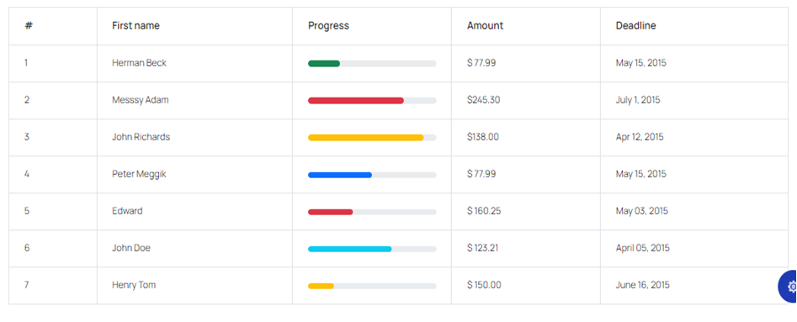
Simple Table

Slide 14
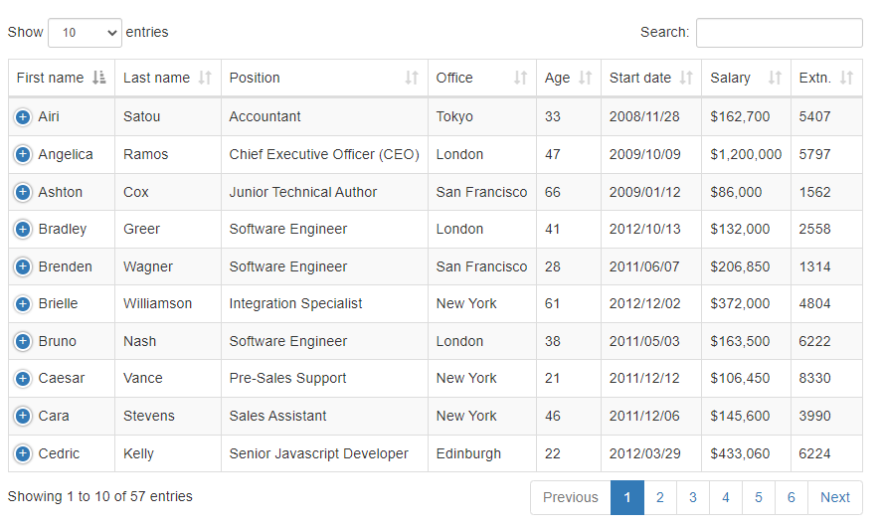
Data Table
  Details
  Operation on table like Sort, Filter, Search and paginations

Slide 15
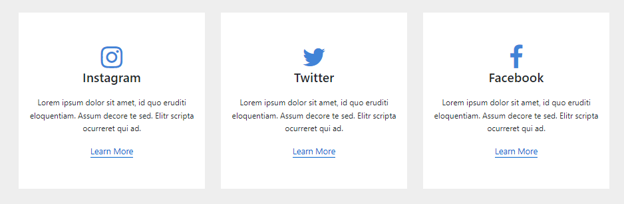
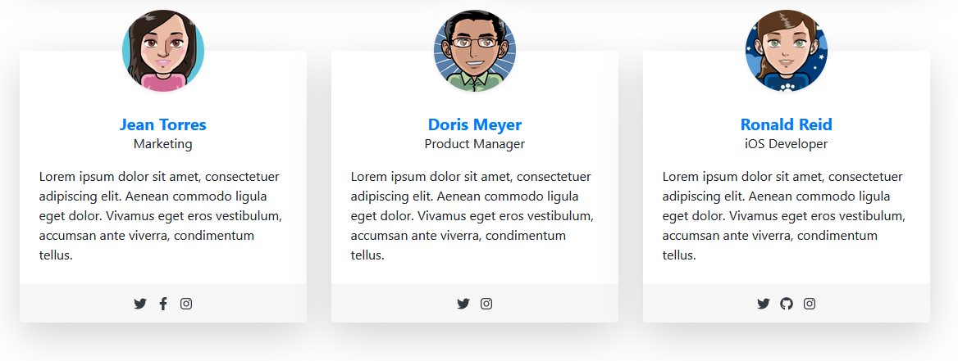
Cards

Slide 16
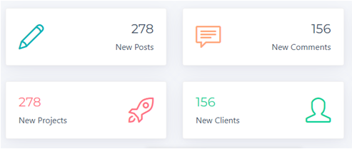
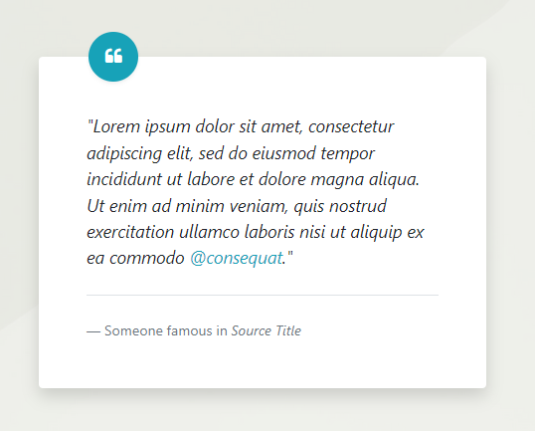
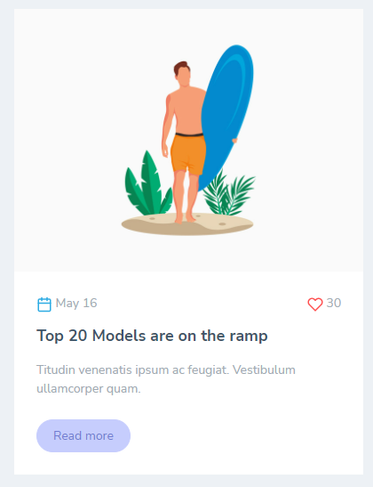
Cards

Slide 17
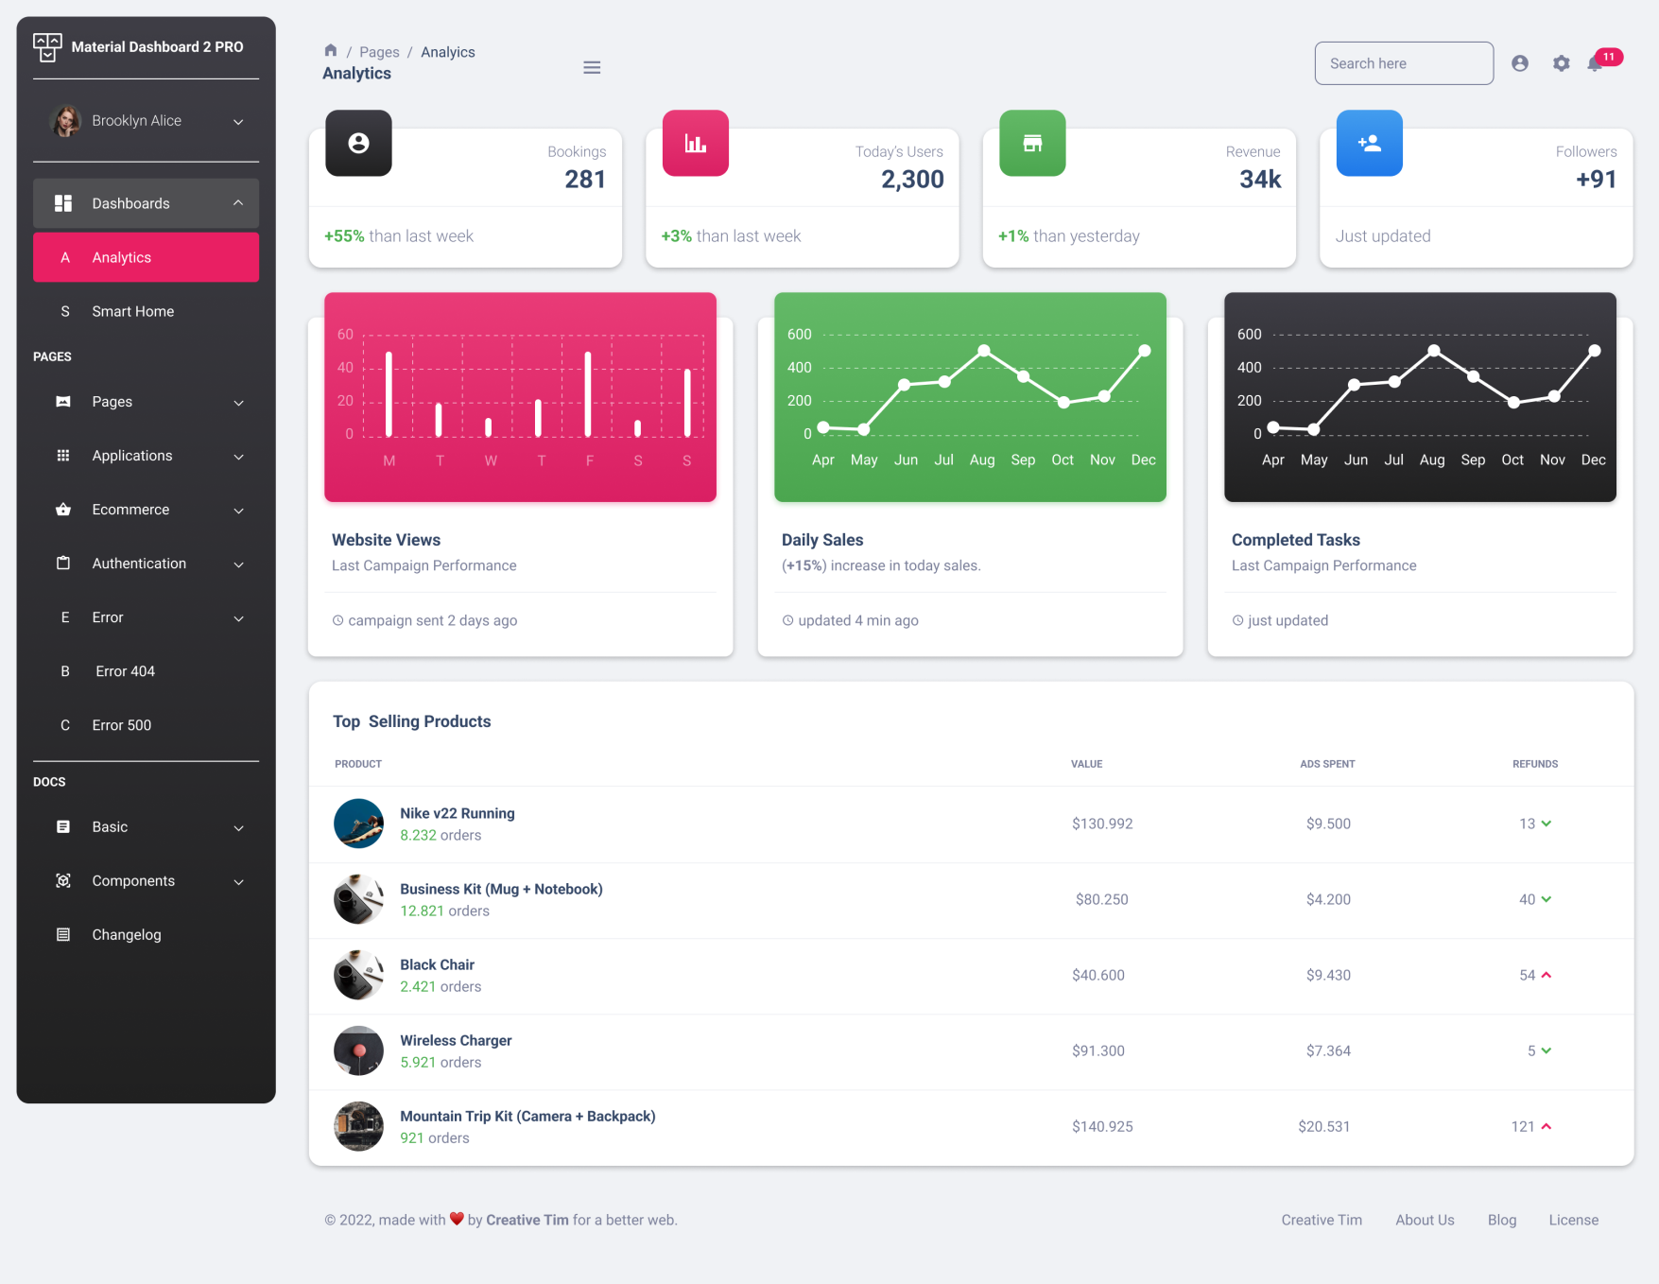
Dashboard

Slide 18
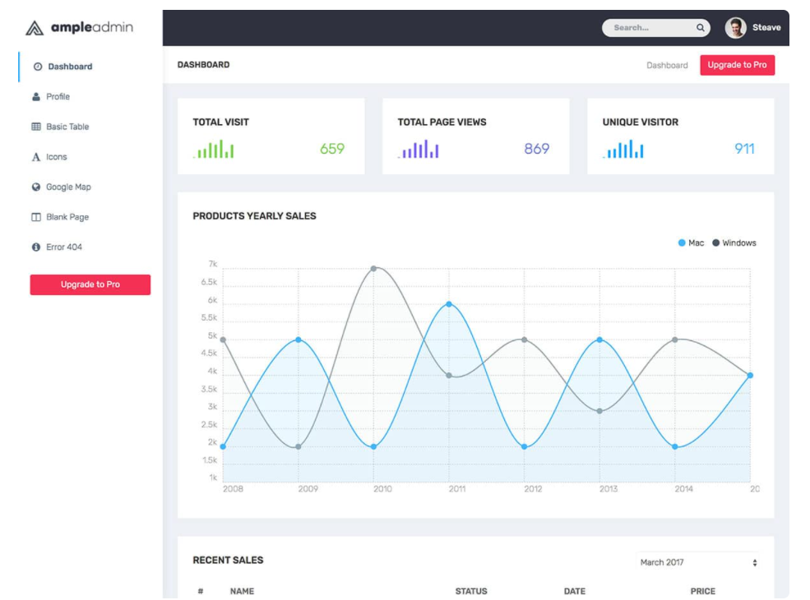
Dashboard

Slide 19
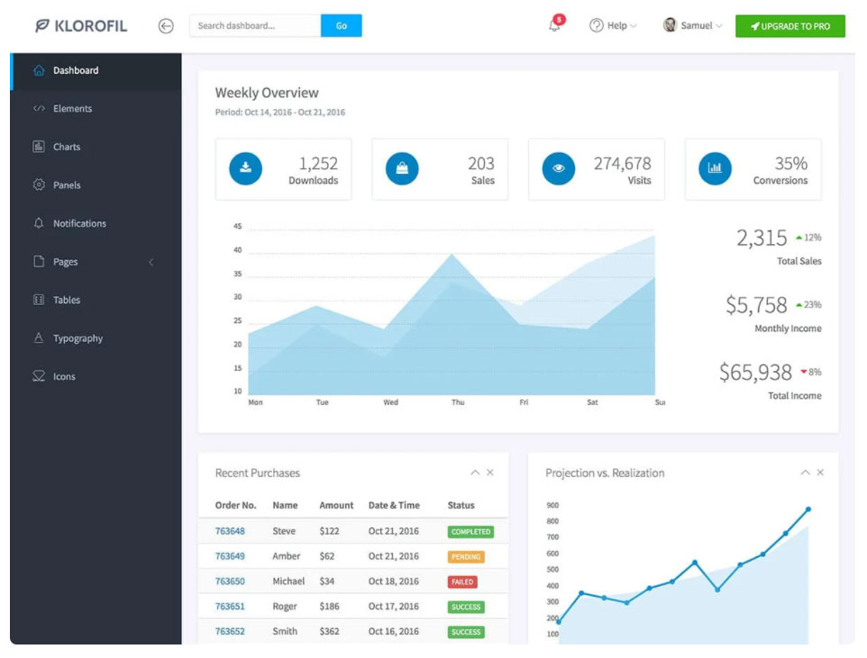
Dashboard

Slide 20
Dashboard
https://flexbox.help/
https://css-tricks.com/almanac/properties/p/position/

